Slide 1
✈ AIRLINE FLIGHT PRICE ANALYSIS
End-to-End Data Analysis & Business Intelligence Project
EDA • Microsoft Excel • Power BI • Tableau
1

Slide 2
Project Overview
OBJECTIVE
WORKFLOW
What this project analyzes
EDA
Excel
• Explore airline flight-price data using Python EDA.
• Understand airline, class, route, departure-time and stops patterns.
• Analyze ticket-price range and flight-duration characteristics.
• Convert analytical findings into Excel, Power BI and Tableau dashboards.
• Communicate results through clear, interactive business visuals.
Explore & validate
Spreadsheet dashboard
01
02
Power BI
Tableau
Interactive BI
Visual analytics
03
04
2

Slide 3
Dataset & Data Quality
Records
Columns
Missing Values
Duplicates
Avg. Duration
300,153
12
0
0
12.22 h
Core variables
Data-quality checks in EDA
• airline • flight • source_city • destination_city
• departure_time • arrival_time • stops • class
• duration • days_left • price
• Dataset shape: (300153, 12)
• All columns contain 300,153 non-null observations.
• Duplicate check returned 0 duplicate rows.
• Descriptive statistics were generated for numeric variables.
3

Slide 4
Key Descriptive Statistics
Average Ticket Price
Minimum Ticket Price
Maximum Ticket Price
20,889.66
1,105
123,071
Average Duration
Avg. Days Left
Max Duration
12.221 h
26.005 days
49.83 h
EDA provides the statistical foundation used by the dashboard stages.
Price range: 1,105 → 123,071 | Duration range: 0.83 → 49.83 hours
4

Slide 5
EDA: Main Analytical Findings
Airline distribution
Class distribution
Vistara
127,859
Business
Economy
Air_India
80,892
93,487
206,666
Indigo
43,120
Visual analysis performed
GO_FIRST
23,173
• Flights by Airline
• Flights by Source City
• Flights by Stops
• Average Price by Class
• Flights by Departure Time
• Duration vs Price • Days Left vs Price • Correlation Heatmap
AirAsia
16,098
SpiceJet
9,011
5

Slide 6
EDA: Relationship Analysis
Analytical relationships
• Flight Duration vs Price — scatter plot used to inspect how price varies with duration.
• Days Left vs Price — scatter plot used to inspect price variation with booking lead time.
• Correlation Heatmap — summarizes correlations among numeric variables.
Duration → Price
Days Left → Price
Numeric Correlations
Relationship explored with a scatter plot.
Relationship explored with a scatter plot.
Correlation matrix visualized as a heatmap.
These analyses support deeper statistical or predictive modeling in a future phase.
6

Slide 7
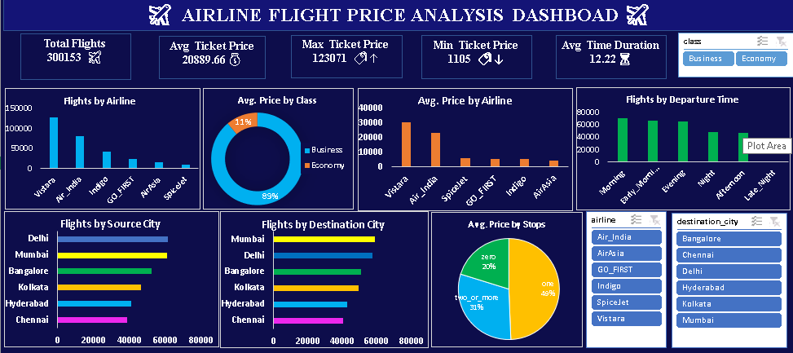
Microsoft Excel Dashboard
KPI cards • Airline analysis • Class analysis • Departure time • Source/Destination city • Stops • Filters
7

Slide 8
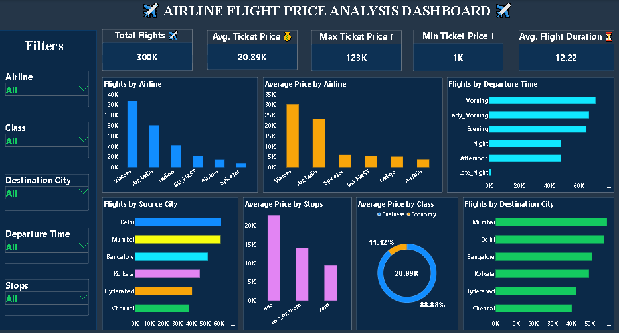
Power BI Dashboard
Interactive slicers: Airline • Class • Destination City • Departure Time • Stops
8

Slide 9
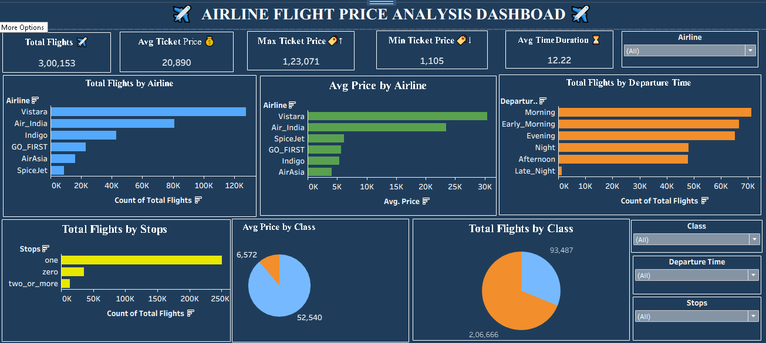
Tableau Dashboard
Interactive filters • Airline comparison • Price analysis • Departure time • Stops • Class
9

Slide 10
Dashboard KPI Summary
Total Flights
Avg. Ticket Price
Max Ticket Price
Min Ticket Price
Avg. Flight Duration
300,153
20,889.66
123,071
1,105
12.22 h
What the dashboards communicate
Consistency across tools
• Overall dataset scale and price range
• Airline-level flight volume and pricing
• Class mix and class-level price views
• Departure-time distribution
• City and stops analysis
• Vistara has the largest record volume.
• Economy is the larger class segment.
• One-stop flights dominate the stops view.
• The dashboards show visible airline-level price differences.
10

Slide 11
Excel vs Power BI vs Tableau
Area
Excel
Power BI
Tableau
Reporting
Spreadsheet dashboard
Interactive BI dashboard
Interactive visual analytics
Filters
Dashboard filters
Slicers
Filters
KPIs
Strong
Strong
Strong
Visual exploration
Moderate
Strong
Strong
Best demonstrated use
Compact reporting
Business intelligence
Visual storytelling
11

Slide 12
Key Findings
flight records analyzed
average ticket price
maximum ticket price
average flight duration
300,153
20,889.66
123,071
12.22 h
01
02
03
04
largest record category
largest class segment
dominant stops category
largest displayed departure-time category
Vistara
Economy
One stop
Morning
05
06
07
08
12

Slide 13
Conclusion & Next Steps
12 • Conclusion
Conclusion
Next analytical phase
• The project demonstrates a complete workflow from EDA to business dashboards.
• EDA validates the dataset and establishes descriptive findings.
• Excel, Power BI and Tableau translate the findings into visual reporting.
• The dashboards consistently communicate airline, class, time, stops, city and price patterns.
• Quantify price relationships using correlation/regression.
• Analyze price by airline × class × stops × days left.
• Add route-level analysis using source and destination combinations.
• Develop a predictive model for ticket-price estimation.
From raw flight data → insights → interactive dashboards
13

Slide 14
THANK YOU
Airline Flight Price Analysis
EDA • Excel • Power BI • Tableau
14

